Slide 1
InsureYou Personalized Insurance Recommendation System
Sivakumar Deivanayagam
Srinivasan lakkala
Tejaswini veeramachaneni
Sri sai Sankalp jagadham
Nandhini Subramanya hoblidar

Slide 2
Agenda
Introduction & Objective
Key Features
Target audience
Technology Stack
Workflow
Estimates
Visual Examples
Benefits
Challenges & Mitigation
Project Milestones
Expected Outcome

Slide 3

Introduction & Objective

Slide 4
introduction
A system that helps users identify the best insurance plans tailored to their financial and health needs.
Combines user data with market analysis to offer personalized recommendations.
Utilizes Azure Data Factory, Microsoft SSMS and PowerBI to perform analysis and visualization

Slide 5
objective
Provide a user-friendly platform for personalized insurance recommendations.
enable informed decision-making using analytics and real-time updates.

Slide 6
Key features

Slide 7
Key features
User Profile Management: Collect and manage secure user data.
Market Trend Analysis: Insights on plan popularity and regional claims data.
Real-Time Updates: Interactive comparison of insurance plans.
Dashboard: Intuitive Power BI visuals for enhanced decision-making.

Slide 8
Target audience

Slide 9
TARGET AUDIENCE
Customers: Individuals looking for suitable insurance plans.
Businesses: Insurance companies seeking market trends.
Stakeholders: Potential sponsors for funding and partnerships.

Slide 10
Technology stack

Slide 11
Technology stack
Data Storage: Azure Blob, Azure SQL Database
Data Engineering: Azure Data Factory, Microsoft SSMS
Visualization: Power BI for interactive dashboards.
Cloud Infrastructure: Azure services for scalability and security.

Slide 12
Workflow

Slide 13
workflow
Streamlined Data Input: Users effortlessly input personal data, which is securely saved in CSV format for subsequent processing.
Seamless Cloud Integration: The saved CSV files are uploaded to the Azure Cloud and stored as Blob files, ensuring accessibility and scalablilty.
Dynamic Data Processing: Azure Data Factory pipelines are executed to extract, transform, and load (ETL) the cleaned datasets into database tables with precision.
Interactive Insights: The enriched database tables are imported into Power BI, enabling sophisticated analysis and visually compelling insights.

Slide 14
Cost estimates

Slide 15
Cost estimates
Resource | Estimated Cost | Specifications
Azure Blob Storage | $20 - $80 / TB | Pay-as-you-go with Hot Storage Tier.
Data Read/Write (Egress) | $10 - $50 per TB | Continuous writes, occasional reads.
Azure Data Factory | $400 - $1,000/month | 1-2 integration runtimes, 8-12 hours/day.
Mapping Data Flows | $0.005/DIU-hour | Estimate 20-100 Data Integration Units (DIU) for heavy transformations.
Azure SQL Database | $500 - $2,000/month | General Purpose tier with 4 vCores/500GB.
Backup Storage | $0.20/GB per month | Automated backups, retention ~30 days.
Power BI Pro | $10/user/month | For smaller teams (~5-10 users).
Power BI Premium | $4,995/month | For large-scale, unlimited dataset size.
Resource | Estimated Monthly Cost | Estimated Yearly Cost
Azure Blob Storage | $50 - $300 | $600 - $3,600
Azure Data Factory (ETL) | $400 - $1,000 | $4,800 - $12,000
Azure SQL Database | $500 - $2,000 | $6,000 - $24,000
Power BI (Pro/Premium) | $100 - $5,000 | $1,200 - $60,000
Total Estimate | $1,050 - $8,300/month | $12,600 - $99,600/year

Slide 16
Visual examples

Slide 17
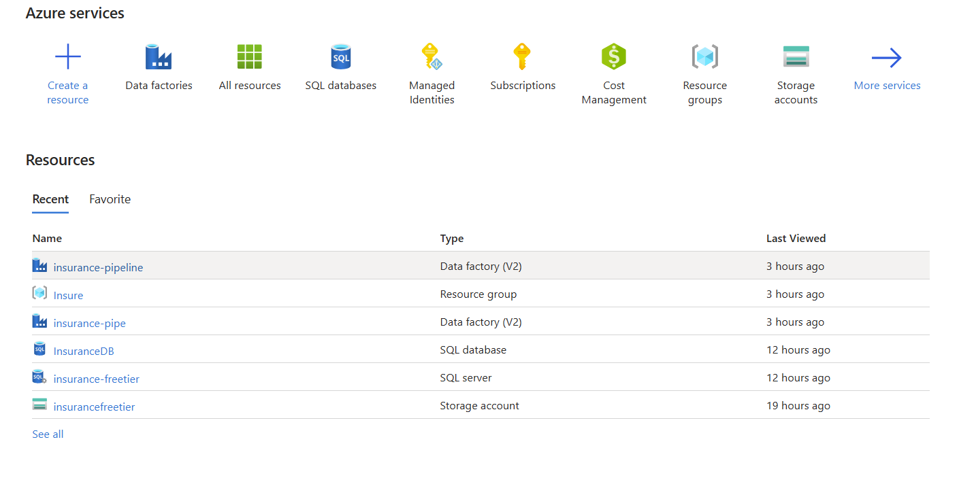
Visual examples

Slide 18
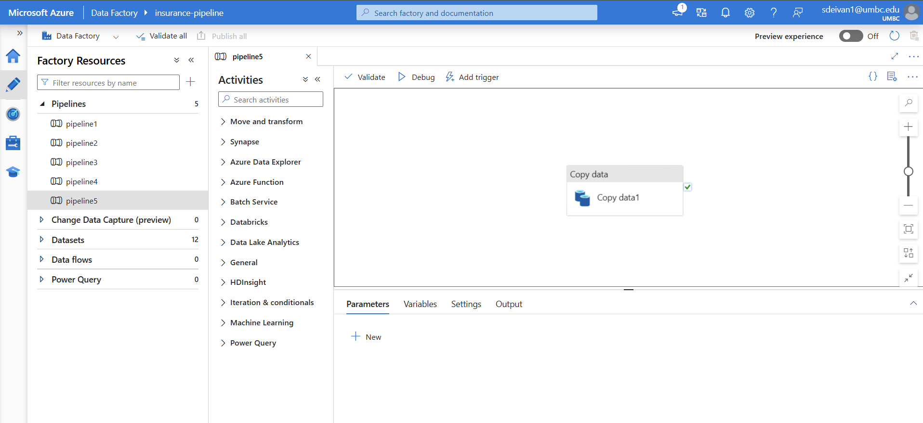
Visual examples

Slide 19
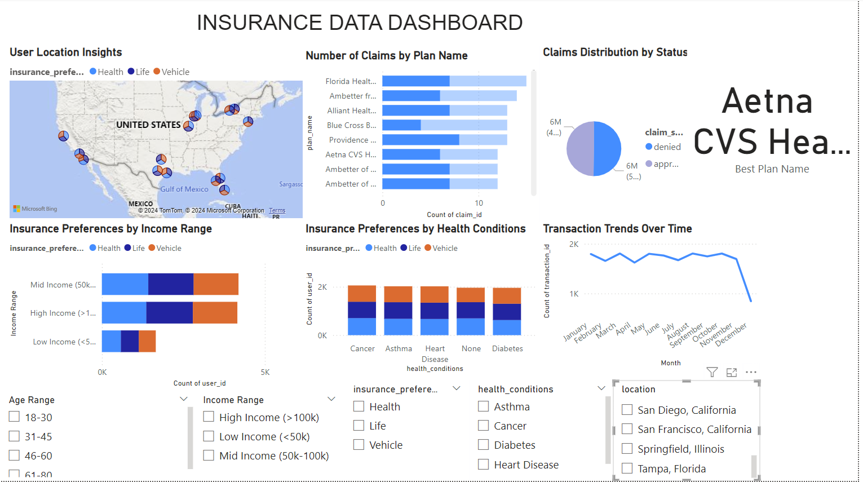
Visual examples

Slide 20
benefits

Slide 21
benefits
For Customers: Simplifies the insurance selection process, offering peace of mind.
For Insurance Companies: Offers market insights to refine offerings.
For Sponsors: Demonstrates innovative use of AI and data analytics in a real-world application.

Slide 22
Challenges & mitigation

Slide 23
Challenges & mitigation
Data Privacy: Encryption and compliance with GDPR/CCPA.
Scalability: Cloud solutions to manage user growth.
Accuracy: Regular updates to recommendation algorithms.

Slide 24
Project milestones

Slide 25
Project milestones
1st Month: Data Collection
2nd Month: Algorithm Development
4th Month: Final Deployment
3rd Month: Prototype Creation.

Slide 26
Expected outcome

Slide 27
Expected outcome
A scalable system that enhances user decision-making.
Highlights team expertise in analytics, cloud computing, and user experience design.

Slide 28
THANK YOU

